Slide 1

People and LLM Landscape Evolution

Slide 2
1 Proprietary Large Language Models Overview

Slide 3

Anthropic's Claude family of models
People and Claude's evolution
The development of Claude models significantly impacts how people interact with AI, driving advancements in human-AI collaboration and understanding.
Claude's role in LLM landscape
Claude models are pivotal in the evolving LLM landscape, offering advanced conversational AI and reasoning capabilities for various applications.

Slide 4
OpenAI's GPT series advancements
People's interaction with GPT
Proprietary LLMs: GPT series
GPT models have transformed how people engage with AI, enabling new forms of creativity, productivity, and information access across diverse sectors.
OpenAI's GPT series stands as a leading example of proprietary large language models, driving innovation in AI research and commercial applications.
GPT's impact on LLM landscape
GPT series advancements
The GPT series from OpenAI has profoundly shaped the LLM landscape, setting benchmarks for generative AI and influencing subsequent model development.
The GPT series continues to see rapid advancements, pushing the boundaries of what large language models can achieve in various complex tasks.

Slide 5
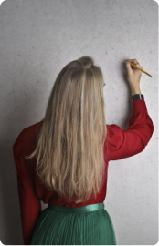
Google's Gemini multimodal capabilities
Gemini's role in LLM landscape
Google's Gemini model, with its multimodal capabilities, is a significant player in the LLM landscape, integrating diverse data types for comprehensive understanding.

Slide 6
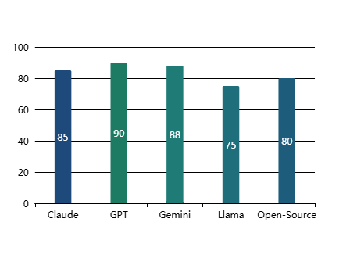
LLM Landscape Overview
Key LLM Models and Families(Impact Score (out of 100))

Slide 7
2 Open-Source LLM Ecosystem and Innovations

Slide 8

Meta's Llama foundational model contributions
Llama in Open-Source Ecosystem
Meta's Llama models are cornerstones of the open-source LLM ecosystem, driving innovation and collaborative development within the AI community.
Llama's Impact on LLMs
Meta's Llama models have significantly advanced the open-source LLM landscape, fostering innovation and accessibility for researchers and developers globally.
People and Llama's Influence
Llama's contributions are shaping how people interact with and develop AI, democratizing access to powerful foundational models for diverse applications.
Normal Model Development
Normal development practices are crucial for ensuring the stability and reliability of large language models across various applications and user scenarios.

Slide 9
Qwen and DeepSeek's emerging capabilities
Human-AI Interaction with Qwen
Innovations in Open-Source LLMs
The evolution of Qwen and DeepSeek is enhancing human-AI interaction, offering more sophisticated and nuanced conversational experiences for users.
Qwen and DeepSeek represent key innovations within the open-source LLM ecosystem, contributing to its diversity and competitive landscape.
Qwen and DeepSeek's Advancements
Typical Model Performance
Qwen and DeepSeek are demonstrating impressive emerging capabilities, pushing the boundaries of what's possible in the open-source LLM space with their unique architectures.
Typical model performance metrics are essential for evaluating the effectiveness and efficiency of new LLM architectures in real-world applications and benchmarks.

Slide 10

Mistral AI's efficient model designs
1
Mistral's Efficient Designs
Mistral AI is renowned for its highly efficient model designs, offering powerful performance with optimized resource utilization, a critical advantage in LLM deployment.
2
People Benefiting from Mistral
Mistral's efficient designs are benefiting people by making advanced AI more accessible and cost-effective, driving broader adoption across industries.
3
Mistral in Open-Source Innovation
Mistral AI's efficient models are a testament to innovation within the open-source LLM ecosystem, setting new standards for performance and efficiency.

Slide 11
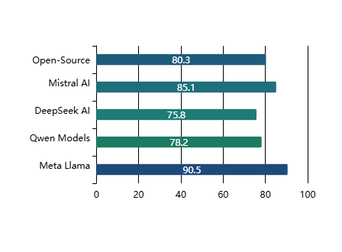
LLM Landscape: Key Models and Contributions
Impact and Innovation in LLM Development(Innovation Score (%))

Slide 12
Thank You

